Slide 1




GROCERY
ARKVerse
STORE
MANAGEMENT
Presented by-
RAMAN .Y
KISHORE .G
ABHISHEK .K

Slide 2


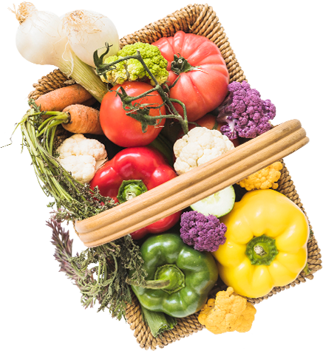



AGENDA :
Objective of the Project
ER Diagram and schema explanation
Key analysis questions (use cases)
SQL query results with screenshots or summaries
Final business insights and recommendations
Conclusion (Key finding overall)
Q&A Slide
Your Experience/Challenges working on SQL – Data Analysis Project

Slide 3
OBJECTIVE :
The main goals of this SQL project are:
To design and implement a relational database for a grocery store.
To retrieve and manipulate data using SQL queries.
To perform data analysis for business insights such as top customers, best-selling products, and revenue trends.
To practice using joins, aggregations, subqueries, and filtering techniques.

Slide 4
INTRODUCTION :
The Retail and Grocery domain requires effective management of inventory, suppliers, customer orders, employees, and product categories.
Efficient data handling helps businesses track sales and revenue, monitor product availability, and analyze operations.
This project simulates a mini grocery store database with interconnected entities like products, orders, and suppliers.
It offers hands-on experience in understanding data relationships and operational workflows.
Students will use SQL to extract and transform data, gaining valuable business insights.
The goal is to improve decision-making and operational efficiency through data analysis.

Slide 5
Key Analysis Questions (Use Cases)
1. Customer Insights
Unique customers who placed orders.
Highest number of orders by a customer.
Total & average purchase value per customer.
Top 5 customers by revenue.
2. Product Performance
Product count by category.
Average price by category.
Best-selling products (by quantity).
Total revenue per product.
Sales comparison by category & supplier.
3. Sales & Order Trends
Total orders & average order value.
Peak order dates.
Monthly order & revenue trends.
Weekday vs weekend order patterns.
4. Supplier Contribution
Total suppliers.
Supplier with most products.
Average price by supplier.
Top suppliers by revenue.
5. Employee Performance
Employees who processed orders.
Most active employees by order count.
Total & average sales value per employee.
6. Order Details Deep Dive
Correlation between quantity & total price.
Average quantity per product.
Price variations across products & orders.

Slide 6
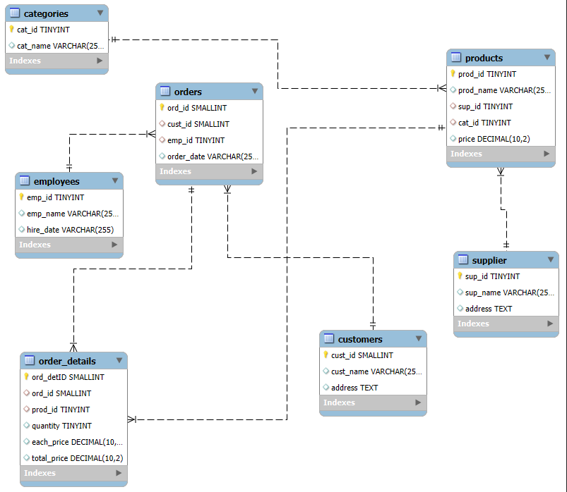
ER Diagram -
`

Slide 7
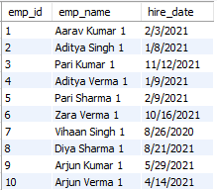
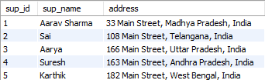
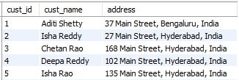
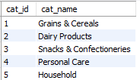
TABLES
Employees
Supplier
Categories
Customers

Slide 8
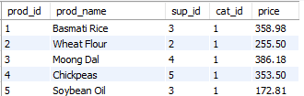
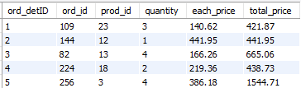
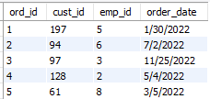
Products
Order_Details
Orders

Slide 9
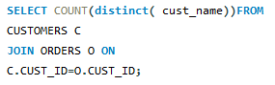
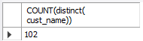
1) How many unique customers have placed orders?
Insights:
102 Unique Customers have placed atleast 1 order counted by their Names.

Slide 10
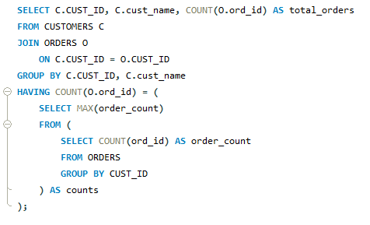
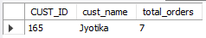
2) Which customers have placed the highest number of orders?
`
Insights:
Customer Jyothika (Cust_Id-165) placed the highest no of Orders, totaling 7 Orders.

Slide 11
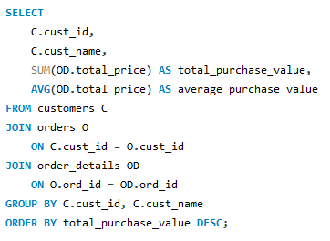
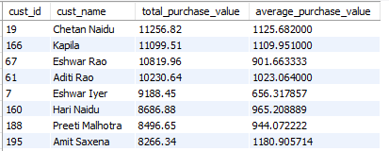
3) What is the total and average purchase value per customer?
Insights:
These customers contribute the Highest Purchase Values.

Slide 12
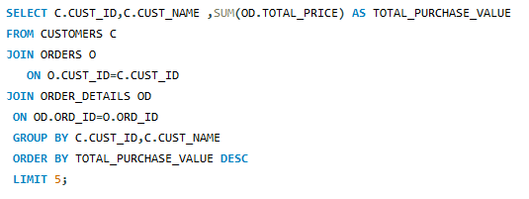
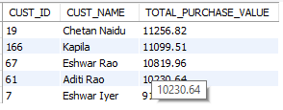
4) Who are the top 5 customers by total purchase amount?
Insights:
These are the top 5 customers by Total purchase amount.

Slide 13
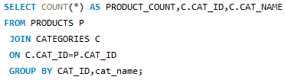
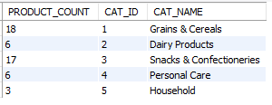
5) How many products exist in each category?
Insights:
Grains & Cereals and Snacks & Confectioneries dominate the product range, while Household has the least variety.

Slide 14
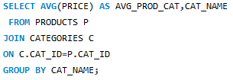
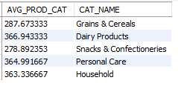
6) What is the average price of products by category?
Insights:
Dairy Products have the highest average price, while Snacks & Confectioneries are the lowest-priced category.

Slide 15
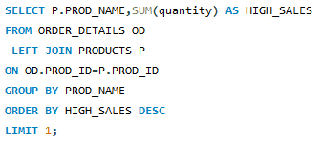
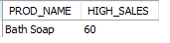
7) Which products have the highest total sales volume (by quantity)?
Insights:
Bath Soap leads in total sales volume with 60 units sold.

Slide 16
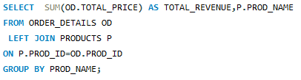
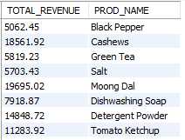
8) What is the total revenue generated by each product?
Insights:
The above table shows the total revenue generated for each product.

Slide 17
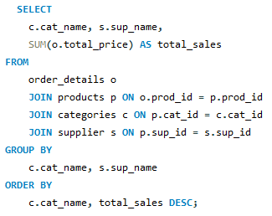
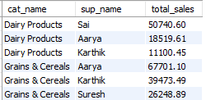
9) How do product sales vary by category and supplier?
Insights:
Grains & Cereals from Aarya have the highest total sales, while Dairy Products from Karthik have the lowest.

Slide 18
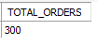
10) How many orders have been placed in total?
Insights:
The total no of orders placed = 300 .

Slide 19
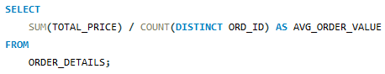
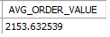
11) What is the average value per order?
Insights:
The average value per order is 2153.6 .

Slide 20
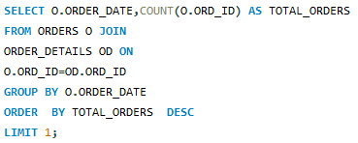
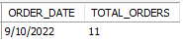
12) On which dates were the most orders placed?
Insights:
D .
Orders

Slide 21
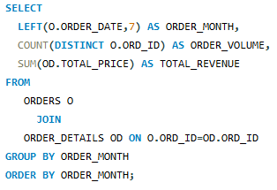
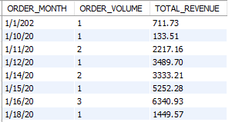
13) What are the monthly trends in order volume and revenue?
Insights:
The query analyzes monthly order patterns, showing how order volume and total revenue fluctuate over time to identify sales trends and seasonal demand shifts.

Slide 22
14) How do order patterns vary across weekdays and weekends?
Insights:
T .

Slide 23
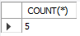
15) How many suppliers are there in the database?
Insights:
No of suppliers in the database are 5 .

Slide 24
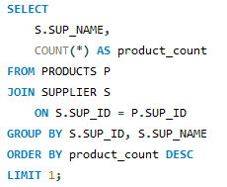
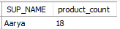
16) Which supplier provides the most products?
Insights:
Aarya is the top supplier, offering the highest number of products at 18.

Slide 25
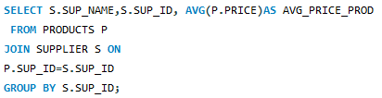
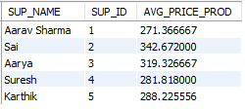
17) What is the average price of products from each supplier?
Insights:
Sai offers the highest average product price at 342.67, while Aarav Sharma offers the lowest at 271.37.

Slide 26
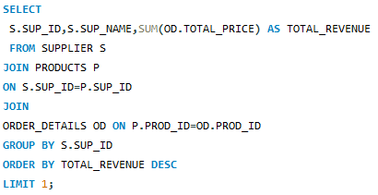
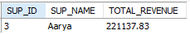
18) Which suppliers contribute the most to total product sales (by revenue) ?
Insights:
Aarya generates the highest total product sales revenue at 221,137.83.

Slide 27
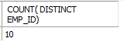
19) How many employees have processed orders?
Insights:
No of employees have processed orders = 10.

Slide 28
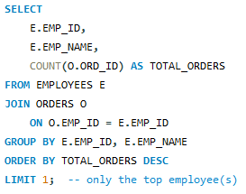
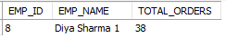
20) Which employees have handled the most orders?
Insights:
Diya Sharma (Emp_Id -8) have handled the most orders (Total Orders =38) .

Slide 29
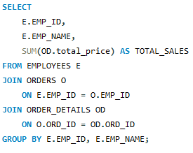
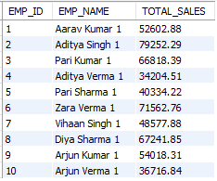
21) What is the total sales value processed by each employee?
Insights:
The above table shows the total value by each employee.

Slide 30
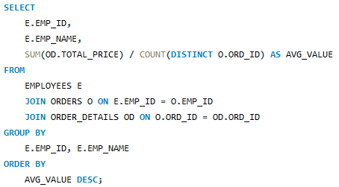
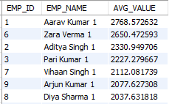
22) What is the average order value handled per employee?
Insights:
Aarav Kumar handles the highest average order value at 2,768.57.

Slide 31
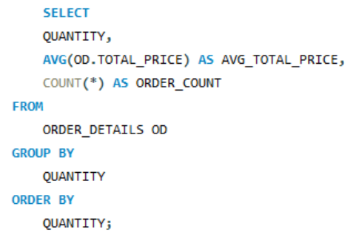
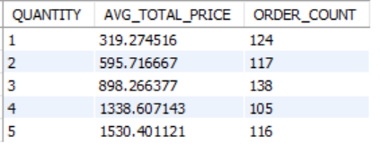
23) What is the relationship between quantity ordered and total price?
Insights:
As quantity ordered increases, th average total prices also increases.

Slide 32


24) What is the average quantity ordered per product?
Insights:
Butter has the highest average quantity ordered(4.556) .

Slide 33


25) How does the unit price vary across products and orders?
Insights:
Unit prices vary significantly across products , but thers no clear direct link between price and order frequency .

Slide 34


Title
THANK
YOU…
__ARKVerse__

Slide 35




Competitive Pricing
Serve Fresh Dishes From Fresh And Healthy Ingredients
A wide selection of organic products that are ready to meet your dining table, ranging from vegetables, fruits and various other organic food ingredients
30% OFF FRUIT & VEGETABLES
30% OFF MILK & DAIRIES
30% OFF
SEASONING
Shop Now
Shop Now
Shop Now

Slide 36
Health and Nutrition
Benefits
Weight Management
Portion-controlled ready meals, low-calorie snacks, dietary supplements supporting healthy weight goals.
Diabetes Care
Sugar-free, low glycemic index products managing blood sugar levels, diabetic-friendly meal options.
Digestive Wellness
Probiotic-rich foods like yogurt, high-fiber products aiding digestion, preventing gastrointestinal issues.
Allergy Management
Gluten-free, nut-free, dairy-free alternatives; clear labeling; safe choices for sensitivities.
Heart Health
Foods low in sodium and cholesterol, high in omega-3s, whole grains, promoting cardiovascular wellness.
Organic Choices
Pesticide-free produce, organic meats reducing chemical intake, better for environment

Slide 37


Parking And Accessibility
Ample parking, handicapped accessibility, convenient location, clean facilities, shopping carts.

Slide 38

Conclusion
A grocery store is a vital community cornerstone, providing diverse nutritional options, fostering health, convenience, and supporting local economies through customer-focused service and sustainable practices.

Slide 39
Icons

Slide 40
Icons

